Slide 1











Masyarakat
Nasabah
Pimpinan
Karyawan
User Access Privilege Policies
Data
Publik
Internal
Data
Toko Online
Online Outlet
Simpan
Pinjam
Data
Asset
Data Transaksi & Keuangan
Portal Informasi
Sistem Retail &
Distribusi
Sistem Simpan/Pinjam
Sistem Akuntansi
Database Access
Database BUMDESA
Global
Database per
BUMDESA

Slide 2


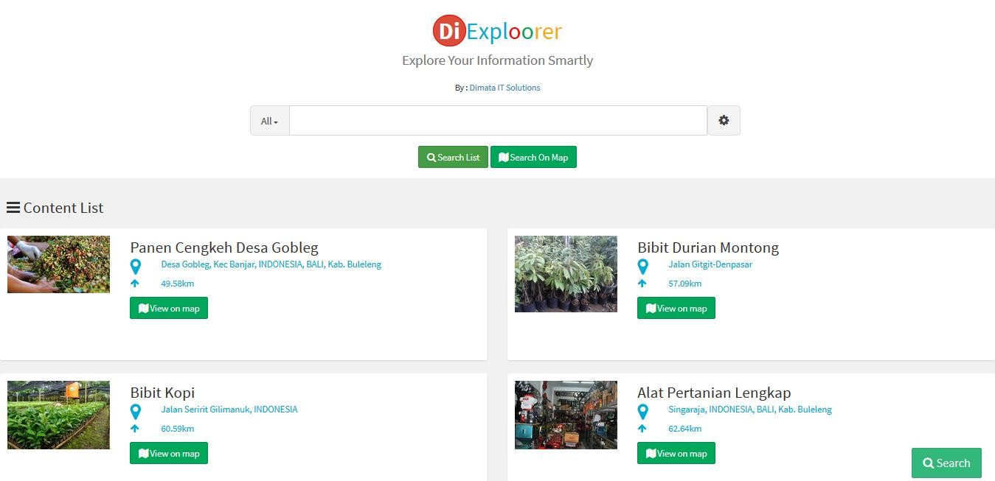

Sistem Portal untuk BUMDESA
www.dimata.com

Slide 3
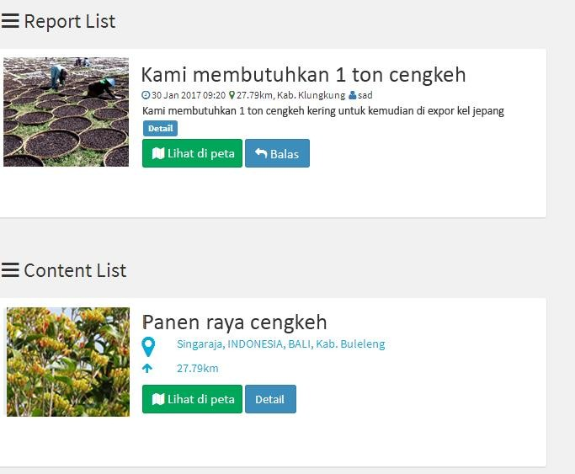
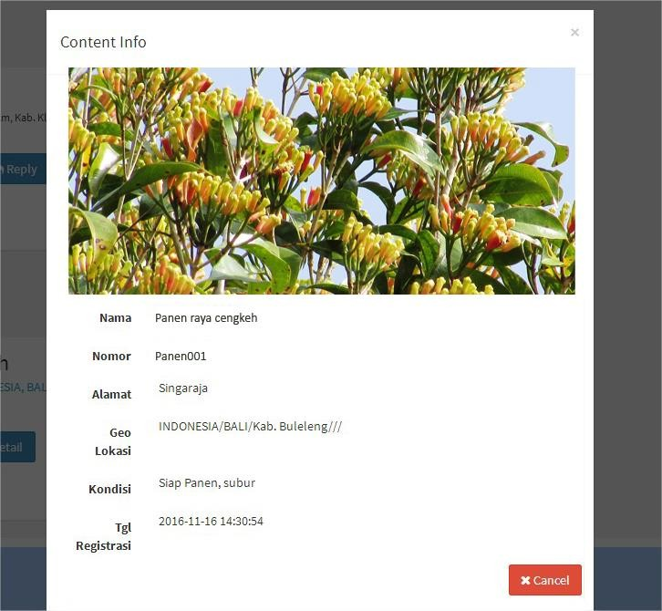
Sistem Portal untuk BUMDESA
www.dimata.com

Slide 4
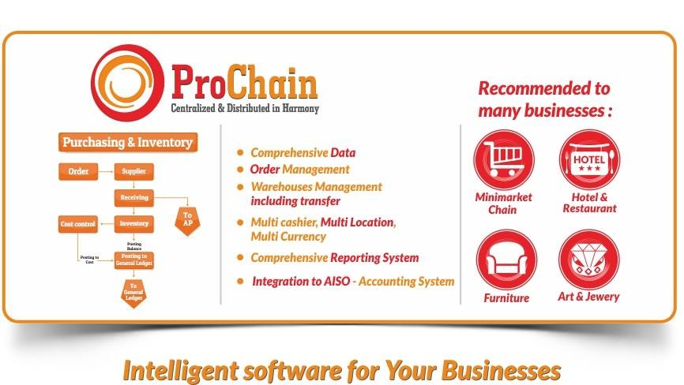
Sistem Jual Beli & Distribusi Serbaguna
www.dimata.com

Slide 5

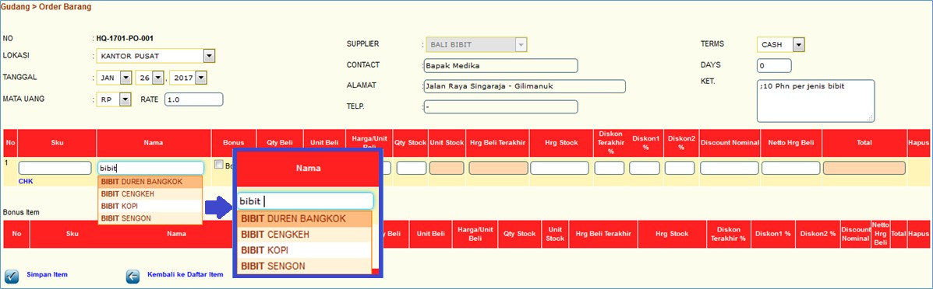
Pembelian (Order)

Slide 6

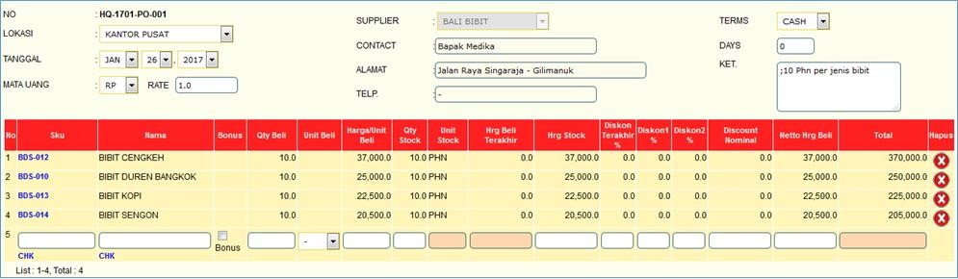
Dokumen Pembelian

Slide 7

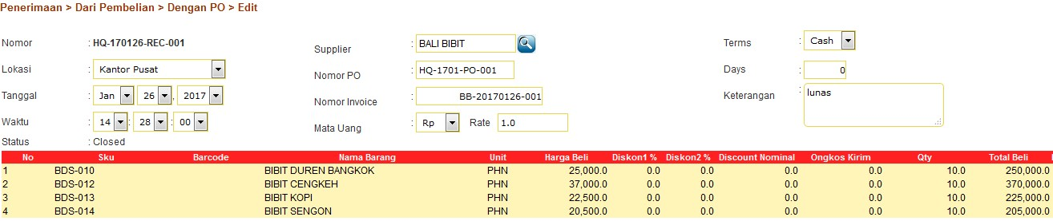
Dokumen Penerimaan

Slide 8

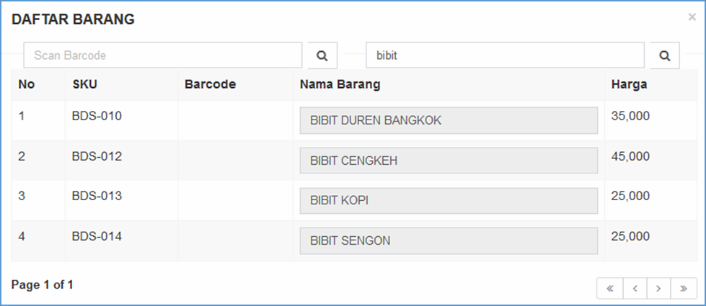
Penjualan

Slide 9

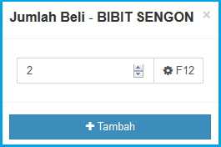
Jumlah Beli

Slide 10

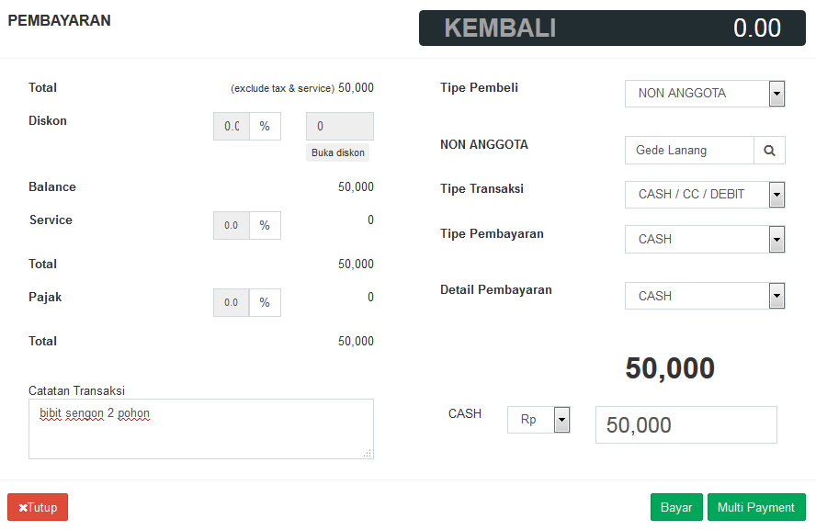
Pembayaran Tipe Non Anggota

Slide 11

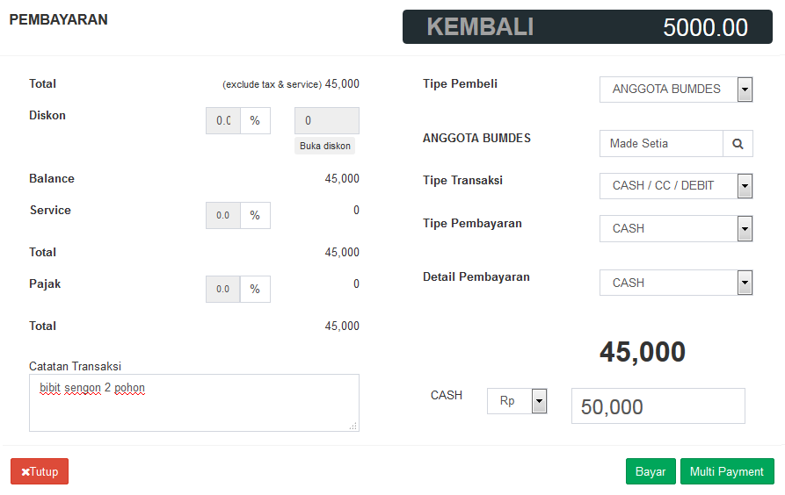
Pembayaran Tipe Anggota

Slide 12
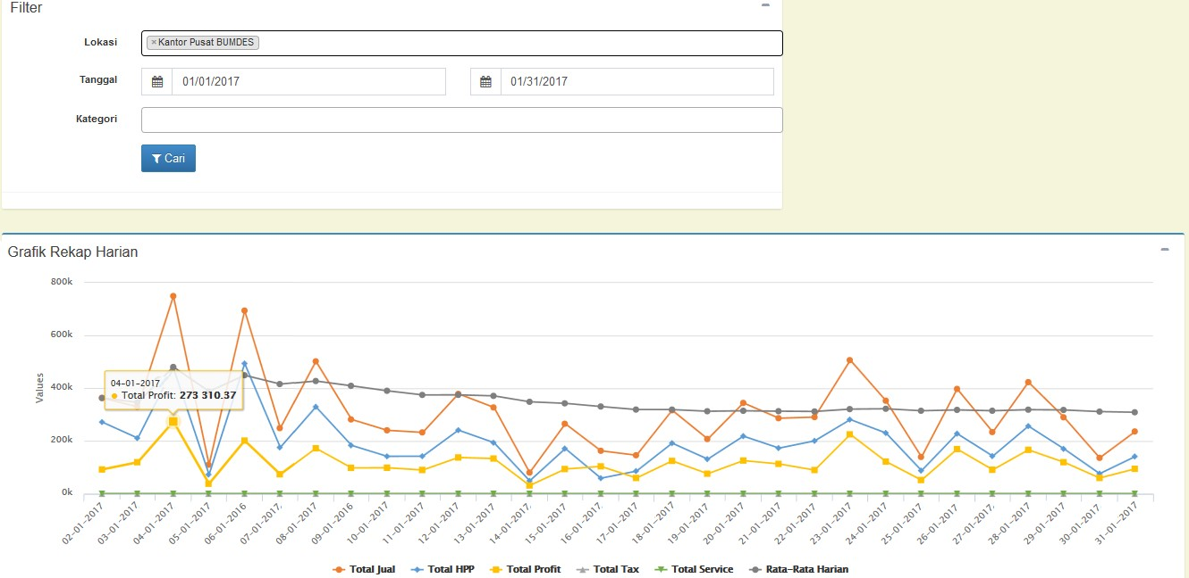
Sistem Akuntansi & Simpan Pinjam Terintegrasi

Slide 13
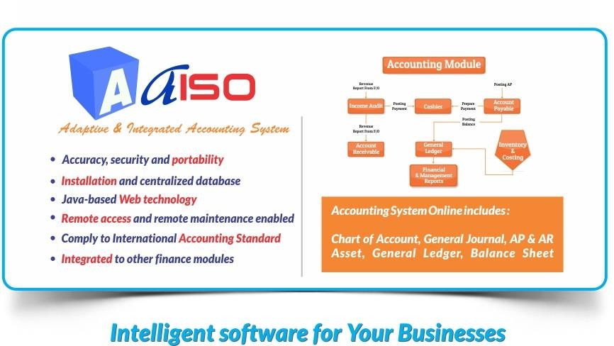
Sistem Akuntansi & Simpan Pinjam Terintegrasi
www.dimata.com

Slide 14
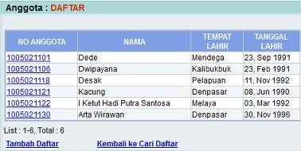
Daftar Anggota & Nasabah

Slide 15
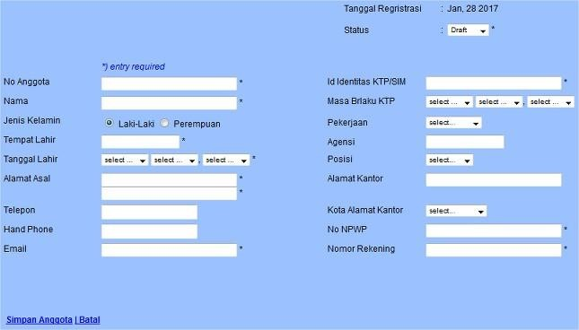
Anggota & Nasabah Baru

Slide 16
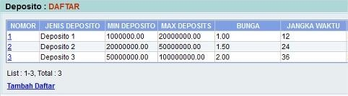
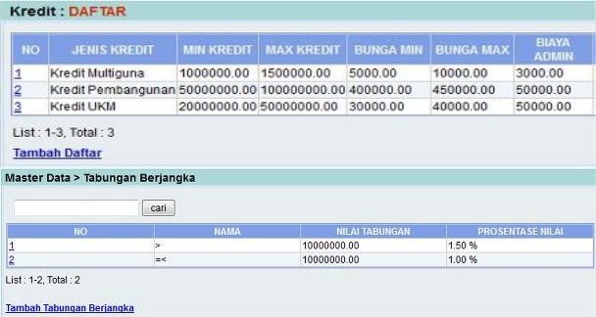
Master Data – Tipe Deposit, Pinjaman & Tabungan

Slide 17
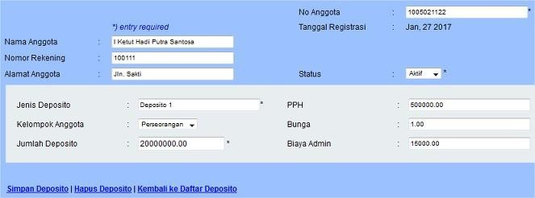
Deposito - Baru

Slide 18
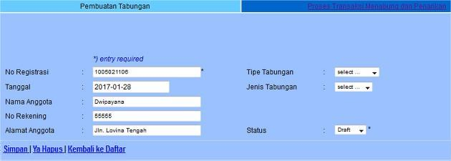
Tabungan – Rekening Baru

Slide 19
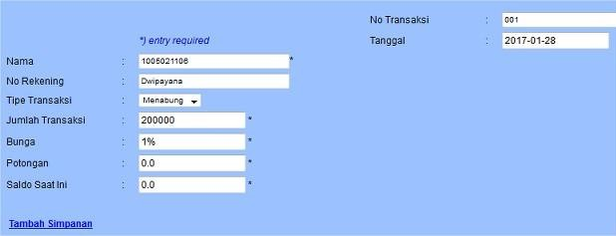
Tabungan – Setoran / Penarikan

Slide 20
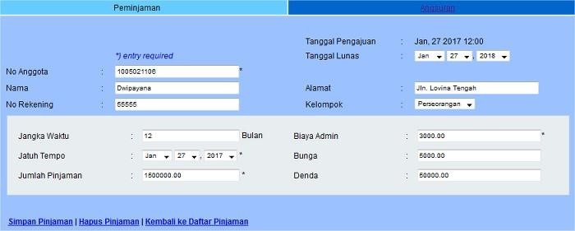
Pinjaman - Baru

Slide 21
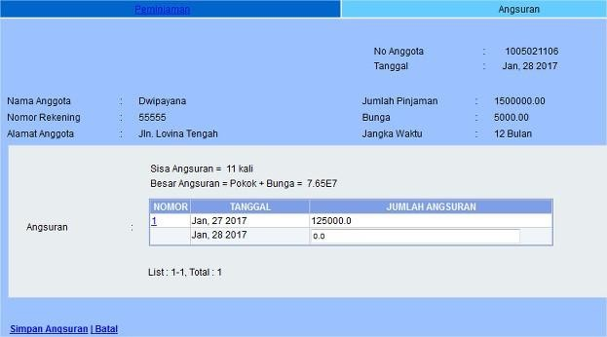
Pinjaman – Pembayaran Angsuran

Slide 22
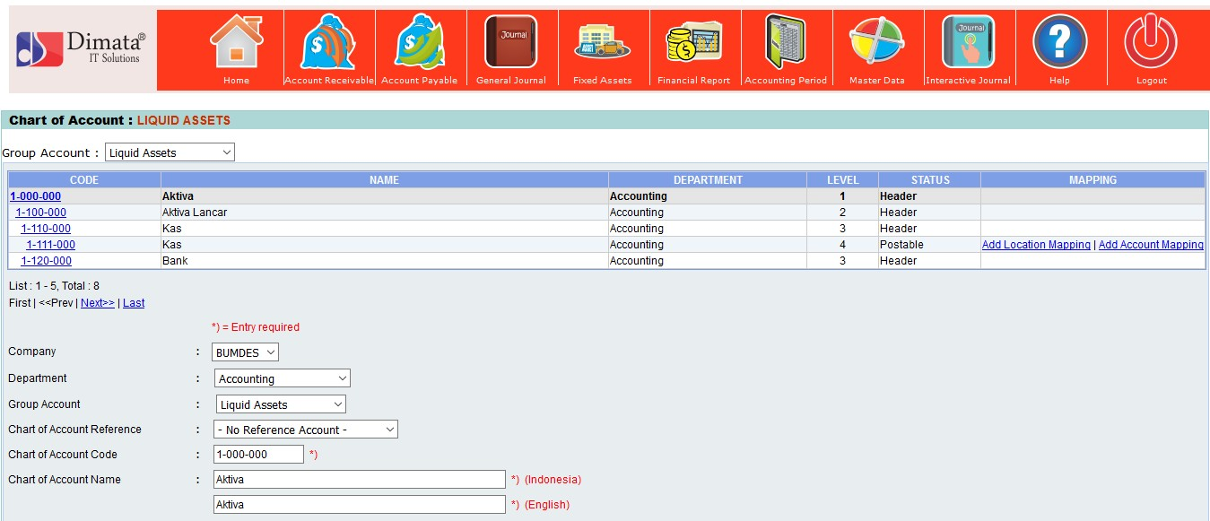
Master Data COA

Slide 23
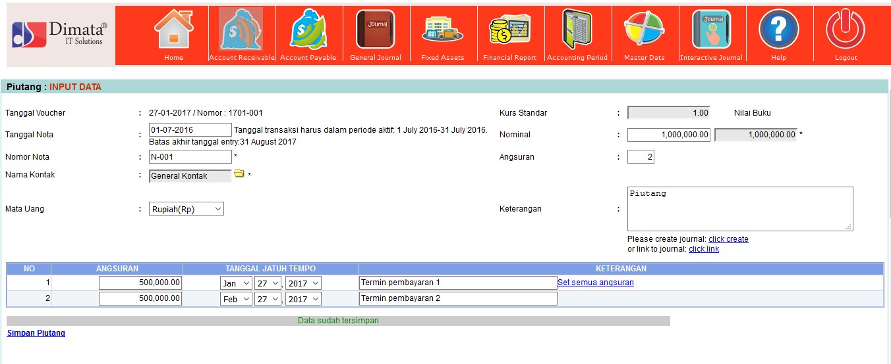
Piutang

Slide 24
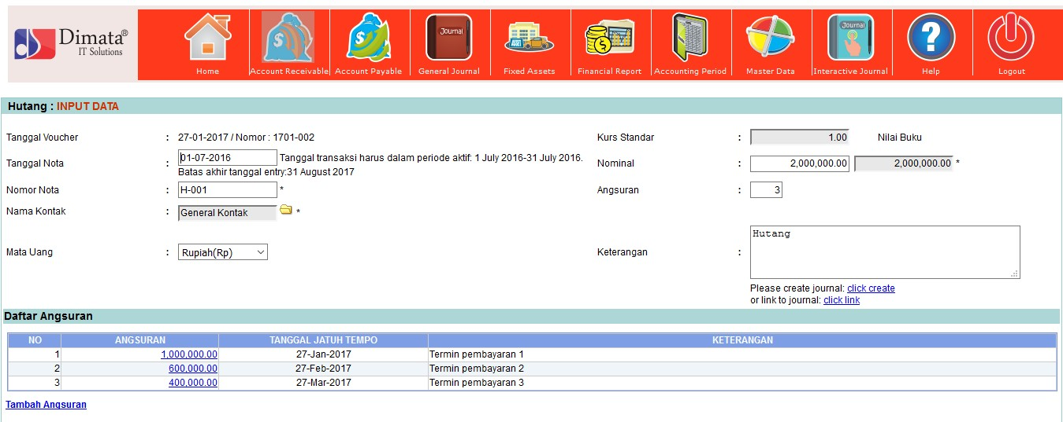
Hutang

Slide 25
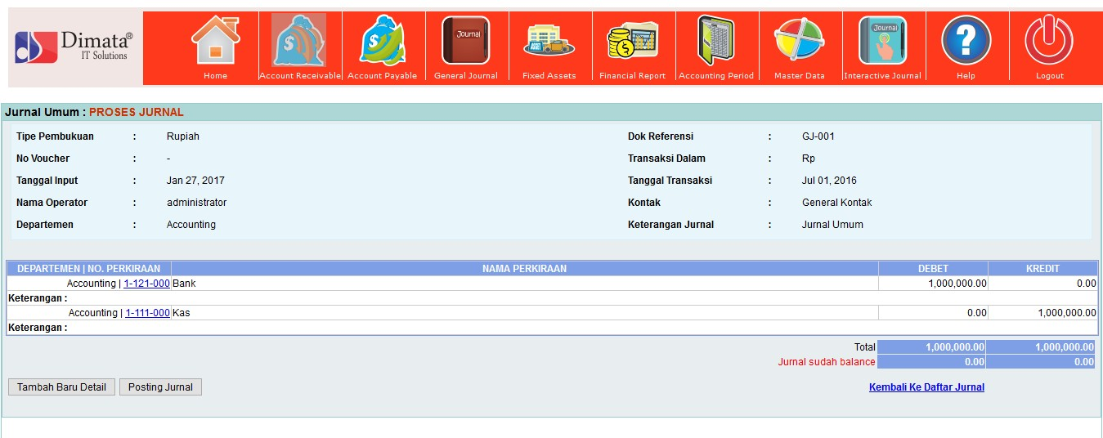
Jurnal Umum

Slide 26
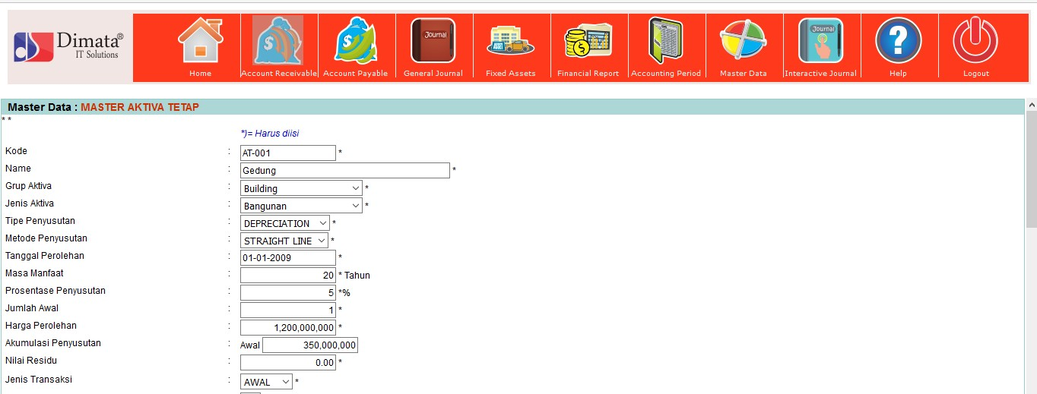
Penginputan Aktiva Tetap

Slide 27
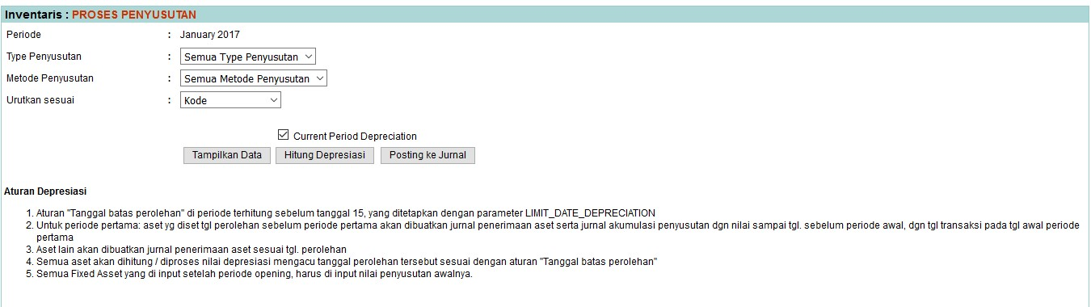
Penyusutan Aktiva Tetap

Slide 28
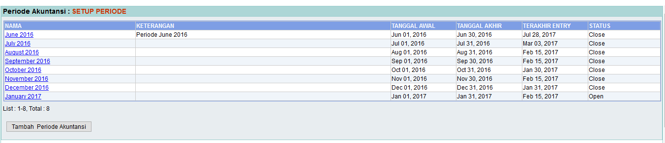
Periode akuntansi

Slide 29
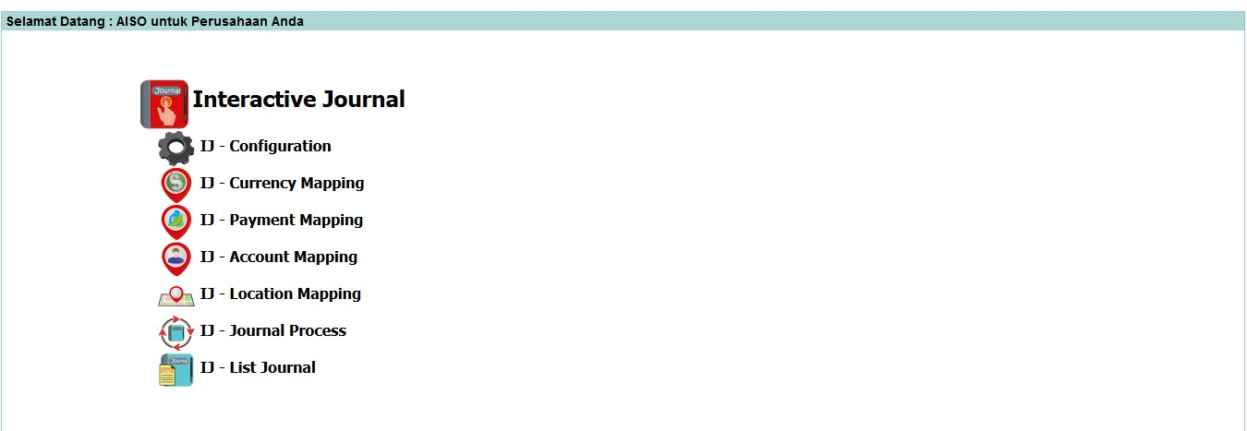
Interactive Jurnal

Slide 30
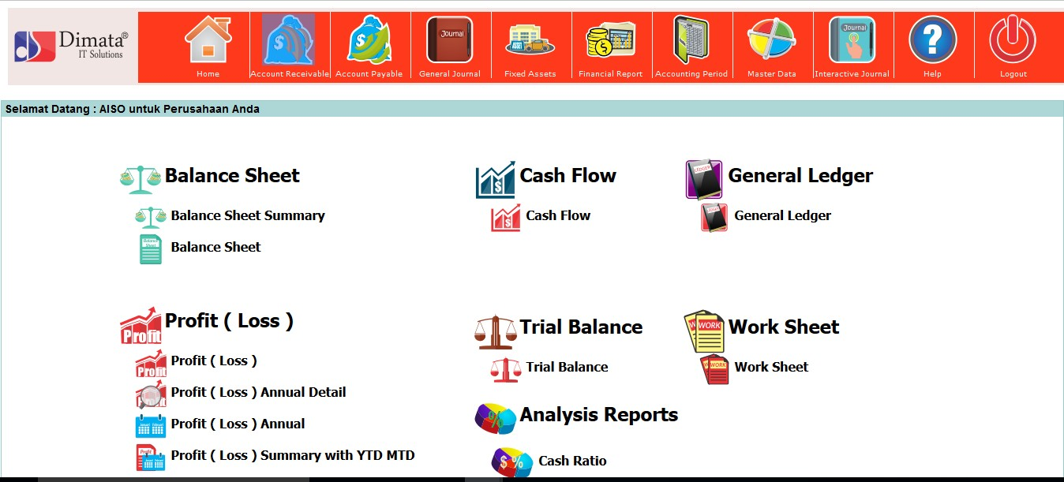
Menu Laporan Keuangan

Slide 31
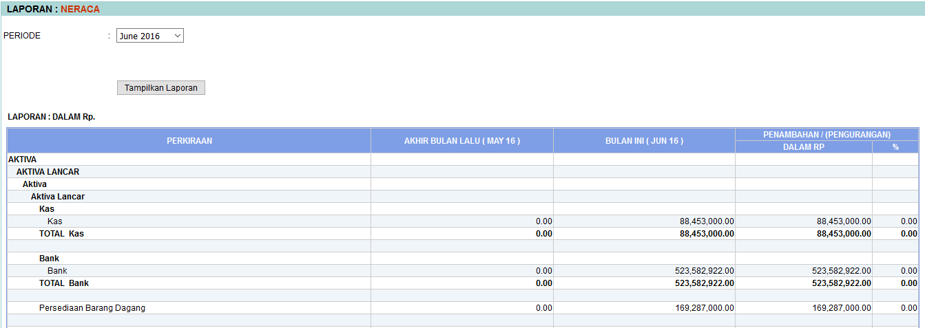
Laporan Neraca

Slide 32
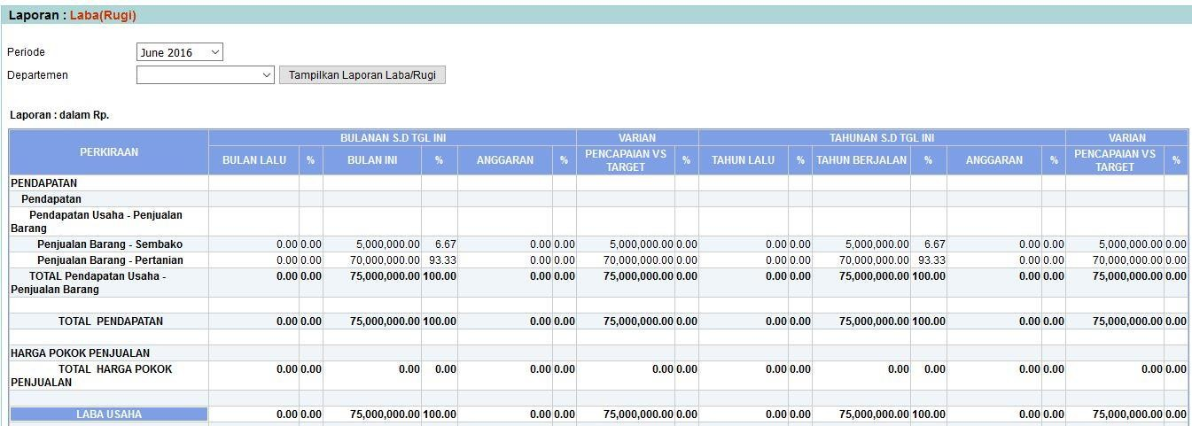
Laba Rugi

Slide 33
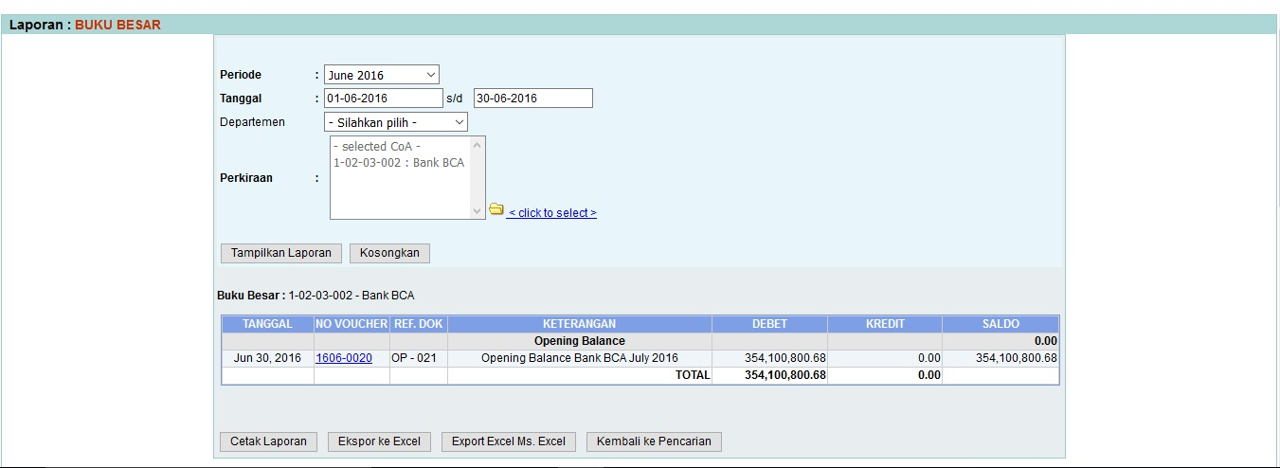
Buku Besar

Slide 34
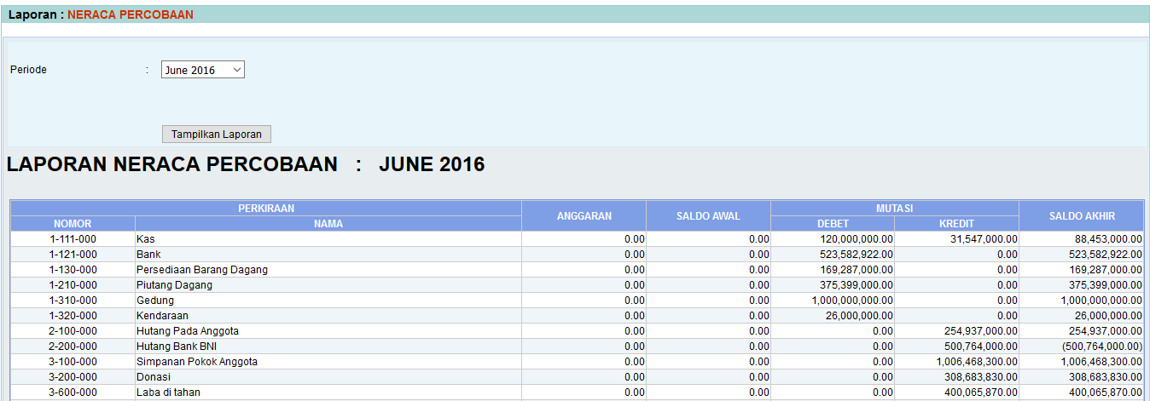
Trial Balance

Slide 35
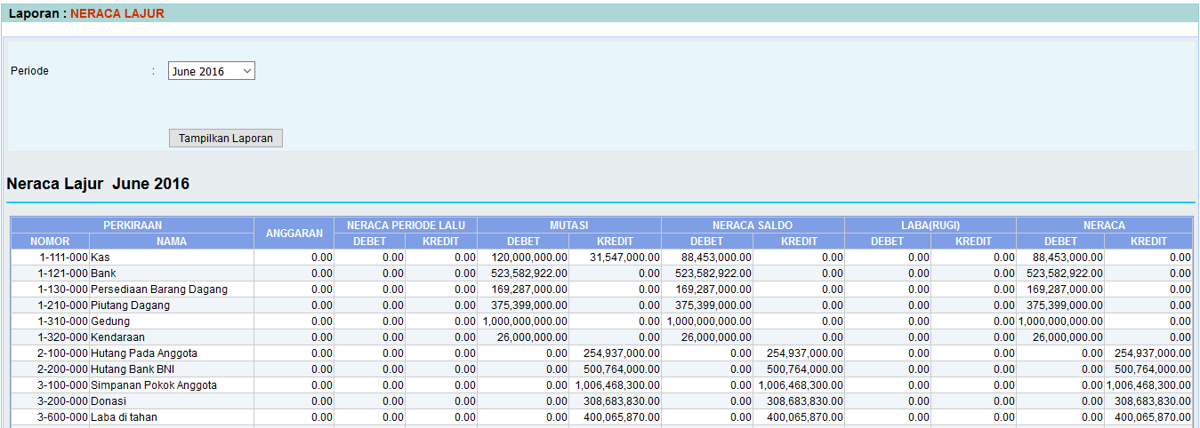
Neraca Lajur

Slide 36

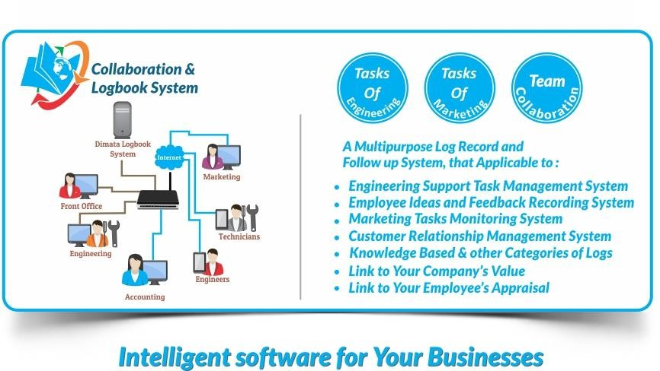
Collaboration & LogBook Sistem
www.dimata.com

Slide 37
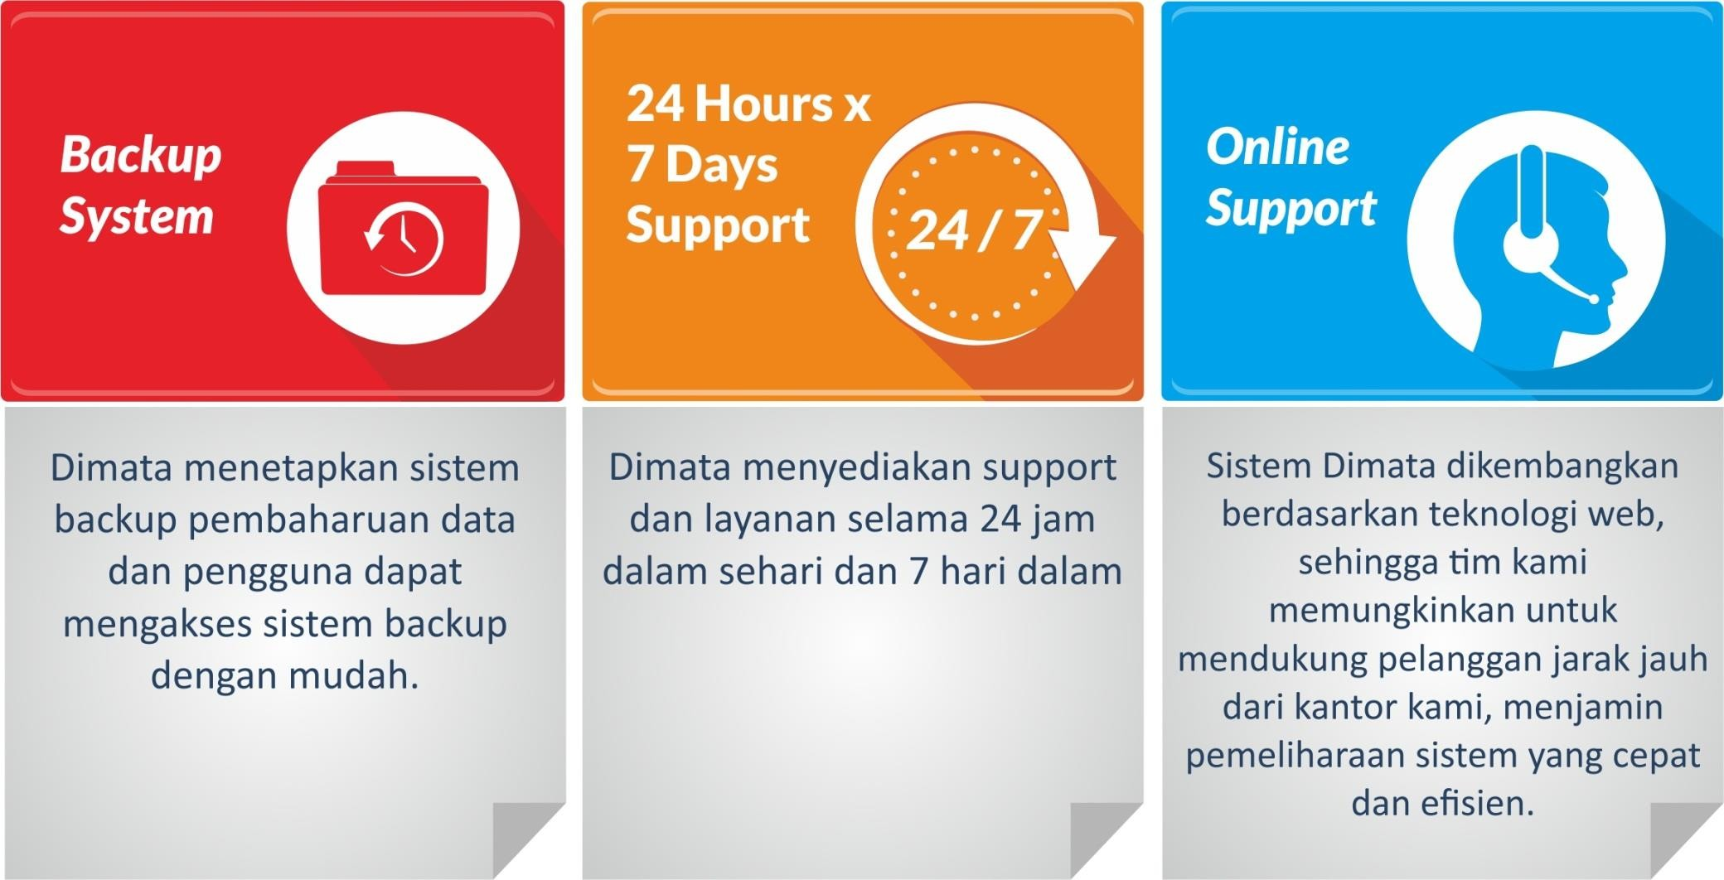
Dimata Support & Service
www.dimata.com

Slide 38





PT Dimata Sora Jayate
Jl. Imam Bonjol, Cipta Selaras 12, Abian Timbul – Denpasar 80119
T : (0361) 499029, 482431, 7869752 F : (0361) 499029
W : http://www.dimata.com E : marketing@dimata.com
www.dimata.com

Slide 39





PT Dimata Sora Jayate
Jl. Imam Bonjol, Cipta Selaras 12, Abian Timbul – Denpasar 80119 T : (0361) 499029, 482431, 7869752 F : (0361) 499029
W : http://www.dimata.com E : marketing@dimata.com
Intelligent IT Solutions
www.dimata.com

Slide 40

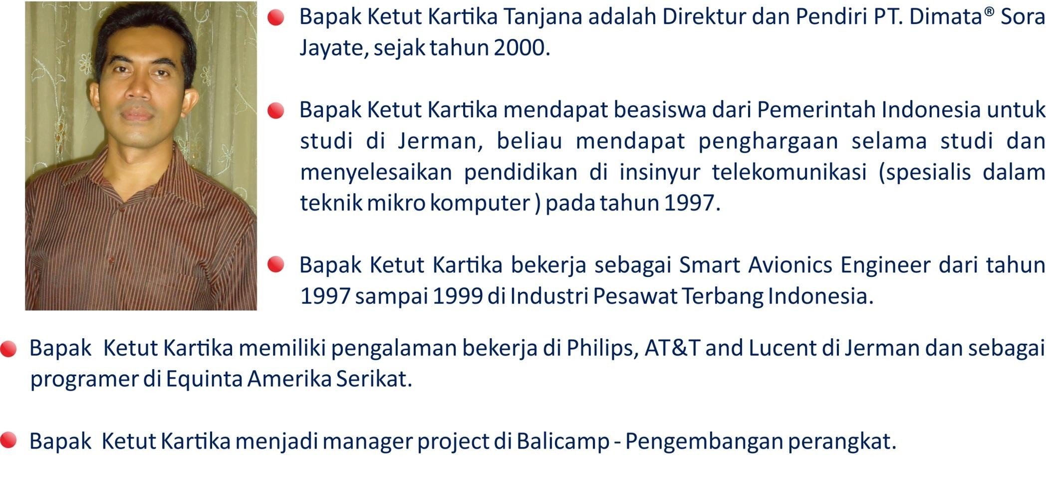
Pendiri Dimata
Mr. Kartika Tanjana is a Director and Founder of Dimata® Sora Jayate, Ltd. since in year
2000.
Mr. Kartika had got a scholarship from Indonesia Government for a study in Germany, he got an award during his study and finished his study in telecommunications engineer (specialist in microcomputer technique) in year 1997.
After completing his study, Mr. Kartika had worked as a Smart Avionics Engineer from
1997 to 1999 at Aircraft Industry of Indonesia.
In Germany, he had work experiences at Philips, AT&T and Lucent. In USA he was a programmer of Equinta.
He was project manager at Balicamp – Software Development
www.dimata.com

Slide 41
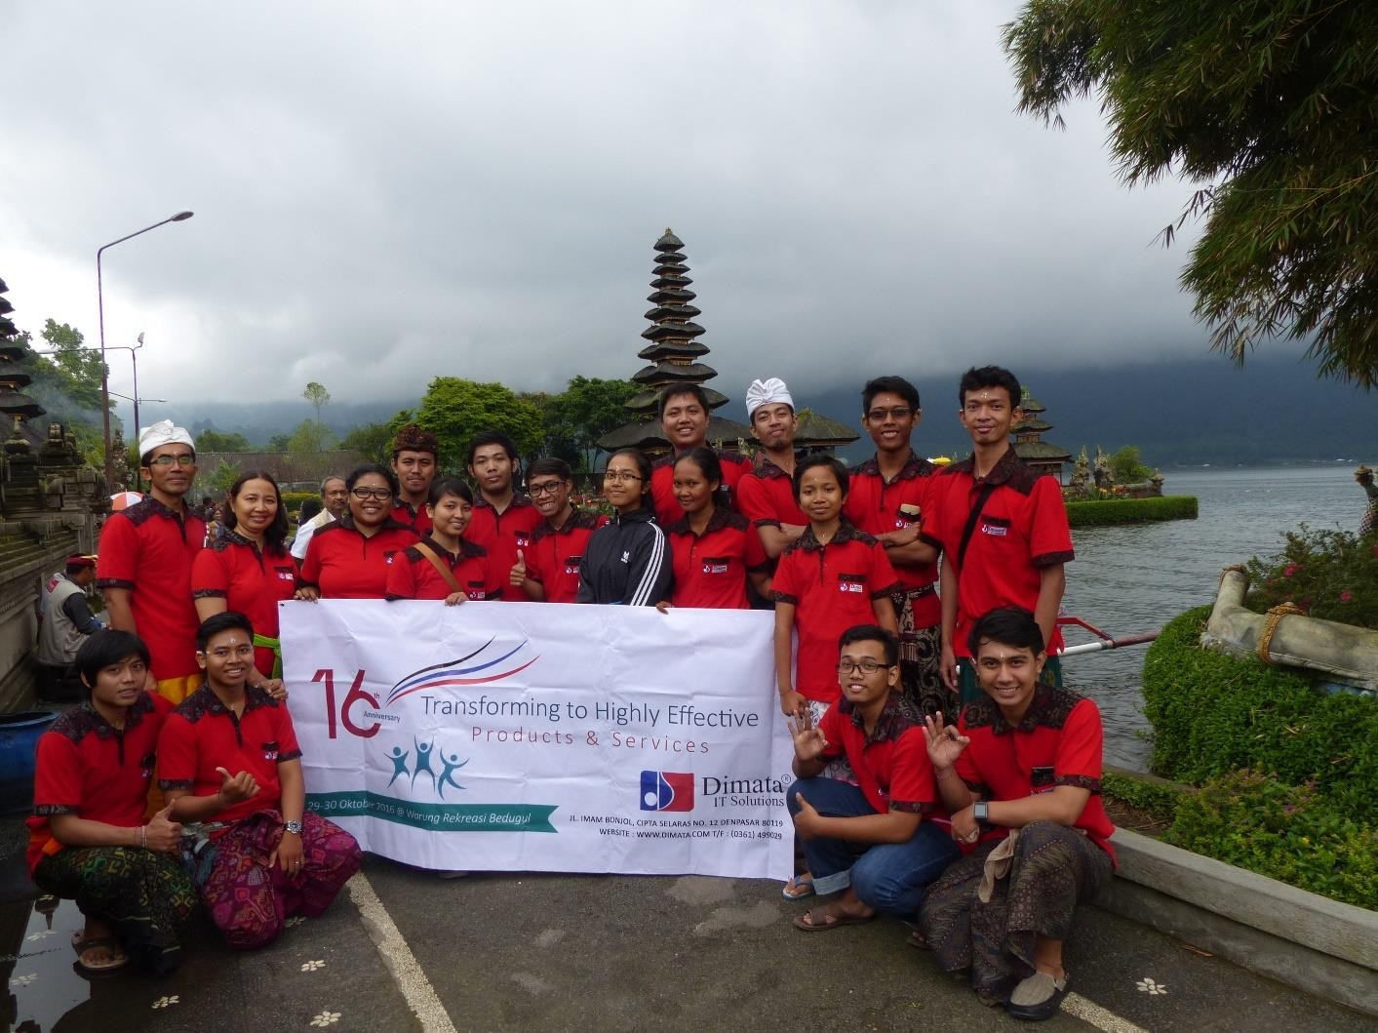
Team Dimata
www.dimata.com

Slide 42
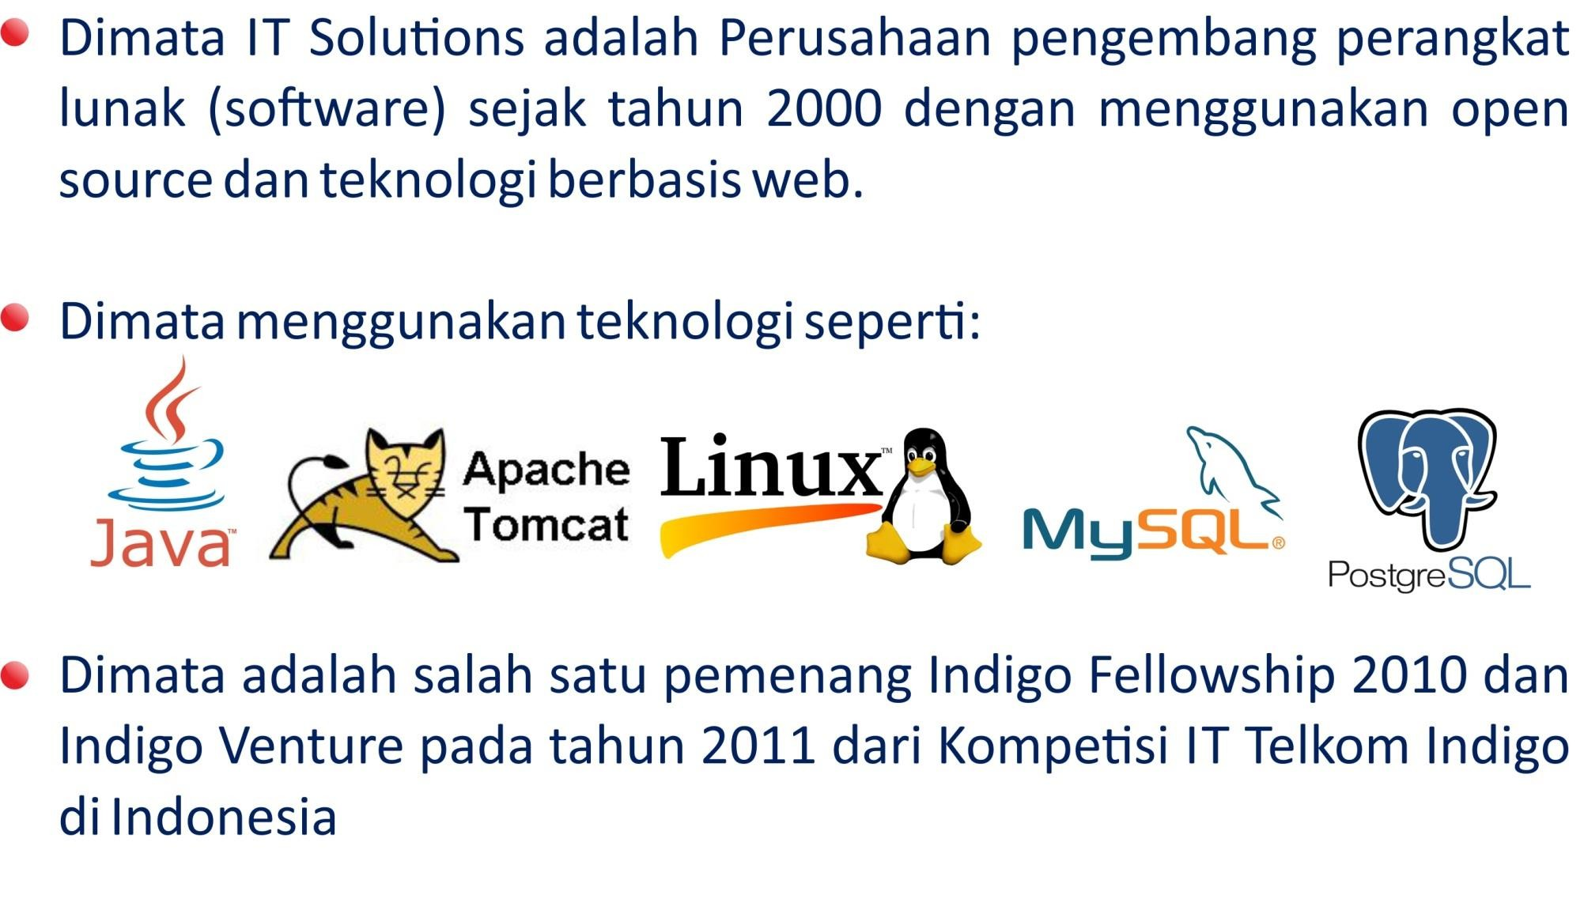
Tentang Dimata
Dimata IT Solutions is a software developer since year 2000 using open source and web-based technologies.
Dimata is mastering in technology such as: Java ™ , Apache /
Tomcat, Linux, Windows, PostgresSQL and MySQL
Dimata is one of the winner of Indigo Fellowship 2010 and Indigo Venture in year 2011 of Telkom Indonesia’s Indigo IT Competition
www.dimata.com

Slide 43
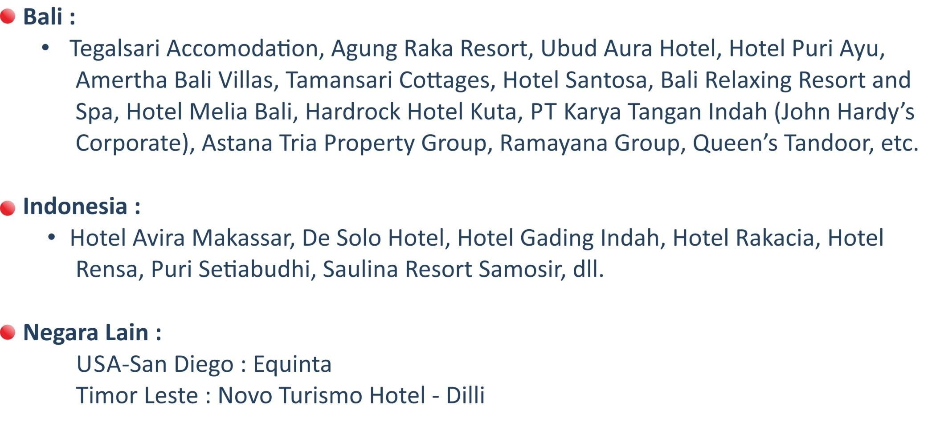
Pelanggan Dimata
Bali :
Tegalsari Accomodation, Agung Raka Resort, Ubud Aura Hotel, Hotel Puri Ayu, Amertha Bali Villas, Tamansari Cottages, Hotel Santosa, Bali Relaxing Resort and Spa, Hotel Melia Bali, Hardrock Hotel Kuta, PT Karya Tangan Indah (John Hardy’s Corporate), Astana Tria Property Group, Ramayana Group, Queen’s Tandoor, etc.
Indonesia :
  Hotel Avira Makassar, De Solo Hotel, Hotel Gading Indah, Hotel Rakacia,
Hotel Rensa, Puri Setiabudhi, Saulina Resort Samosir, etc.
Other Countries :
USA-San Diego : Equinta
Timor Leste : Novo Turismo Hotel - Dilli
www.dimata.com

Slide 44
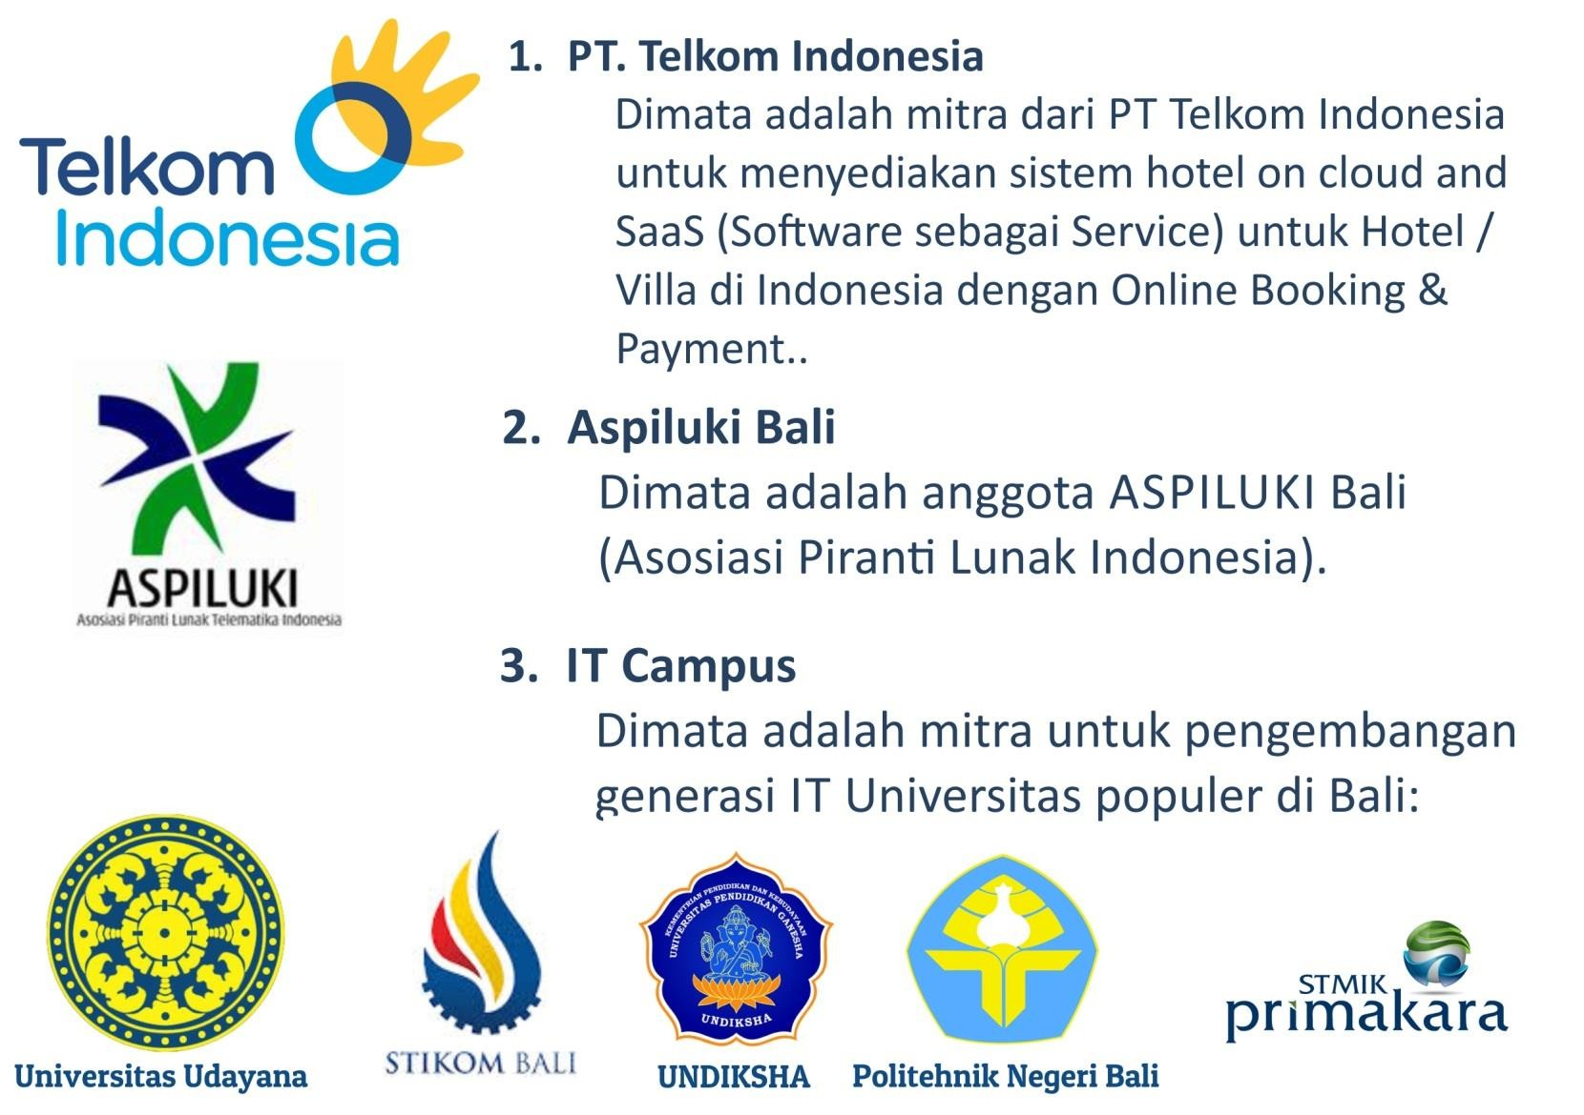

Partner Dimata
1. PT. Telkom Indonesia
Dimata is partner of PT Telkom Indonesia to provide
hotel system on cloud and SaaS (Software as a
S Hotel/Villa in Indonesia with Online
B Payment
Aspiluki Bali
Dimata is a member of ASPILUKI Bali (Asosiasi Piranti
Lunak Indonesia)
IT Campus
Dimata is a partner for development of IT generation of popular Universities in Bali : Udayana University, Poltek Udayana, Stikom Bali, Undhiksa, Primakara
ervice) for ooking &
www.dimata.com

